Slide 1
DO YOU DARE TO SHOW YOUR TRUE COLOURS?
Anas & Rachelle

Slide 2
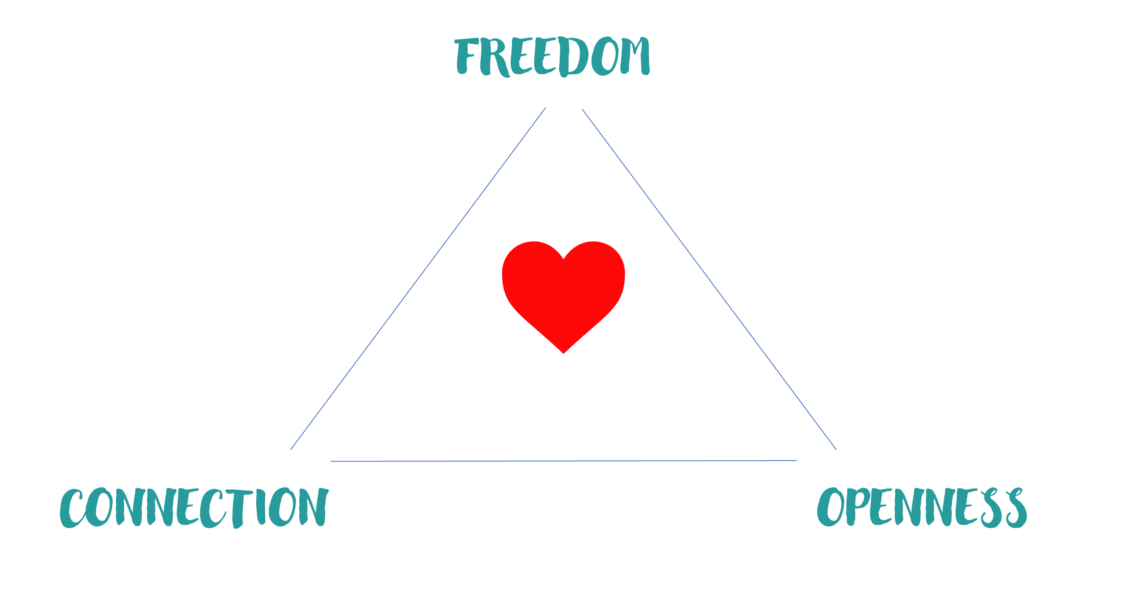

Slide 3
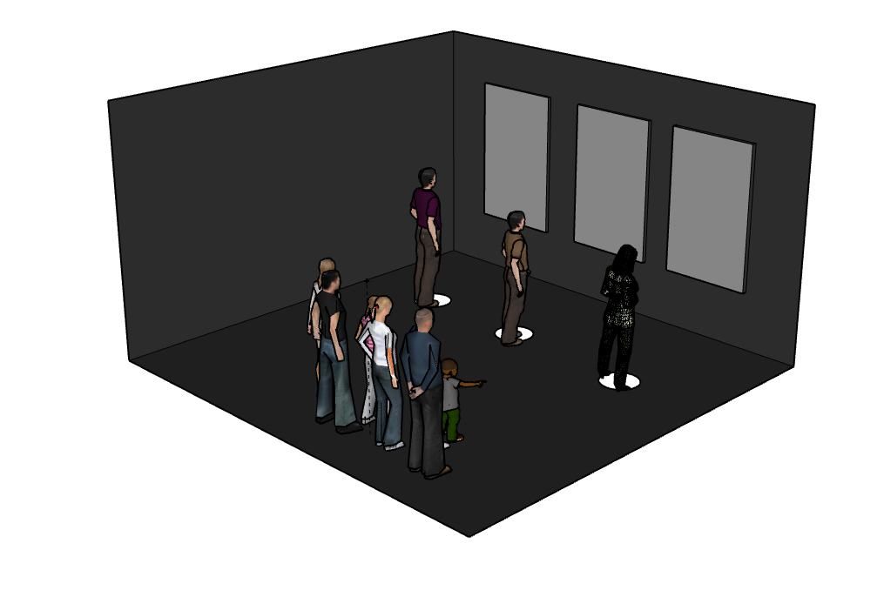

Slide 4
THE IMPACT

